Slide 1


FAKE NEWS DETECTION IN SOCIAL MEDIA
USING IBM WATSON

Slide 2
TEAM MEMBERS
SHASHI KIRAN AND JAYANTHI
FACULTY
CSE-4008
PROF. MEGHAVATHU SS NAYAK
SOCIAL NETWORK ANALYSIS

Slide 3


CONTENT
01
Abstraction
02
Introduction
03
Idea behind the project
04
Block Diagram
05
Strategy and Deployement
06
Code
07
Conclusion
08
References

Slide 4
ABSTRACT
The widespread dissemination of fake news on social media and various other platforms poses a significant concern due to its potential to cause social and national harm with severe consequences. Numerous research efforts have been dedicated to detecting fake news. This paper conducts an analysis of research related to fake news detection and explores traditional machine learning models to select the most suitable one. The aim is to develop a product model using a supervised machine learning algorithm capable of classifying fake news as true or false, utilizing tools such as Python's scikit-learn and NLP for textual analysis. This process involves feature extraction and vectorization. We propose using the Python scikit-learn library for text data tokenization and feature extraction, as it provides useful tools like CountVectorizer and TfidfVectorizer. Subsequently, we will employ feature selection methods to experiment and select the most appropriate features to achieve the highest precision, as indicated by confusion matrix results.

Slide 5
INTRODUCTION
The project "Fake News Analysis in Social Media using IBM Watson" utilizes IBM Watson's powerful tools and technologies to combat the spread of fake news on social media platforms. By leveraging Watson's natural language processing (NLP) capabilities, the project analyzes news articles and social media posts to identify linguistic cues and patterns that indicate the presence of fake news. Machine learning models trained with labeled data help classify news articles as authentic or fake. Additionally, Watson's cognitive computing capabilities are employed to fact-check news content and cross-reference it with trusted sources. Social media analytics tools monitor the spread of news articles, enabling the project to identify trends and influencers associated with fake news dissemination. Interactive applications or chatbots powered by Watson engage with users, providing real-time feedback on the credibility of news articles. The project aims to empower users with information to make informed decisions and contribute to a healthier information ecosystem.

Slide 6

IDEA BEHIND THE PROJECT
The purpose of the project "Fake News Analysis in Social Media using IBM Watson" is to combat the spread of fake news on social media platforms and promote a healthier information ecosystem. By leveraging IBM Watson's capabilities, the project aims to detect and identify fake news, verify the accuracy of news content, empower users with tools for informed decision-making, raise awareness about fake news, and promote a healthy information ecosystem. The project seeks to mitigate the negative effects of fake news, enhance trust in information sources, and encourage responsible engagement with news content on social media, ultimately contributing to a more informed and discerning society.

Slide 7
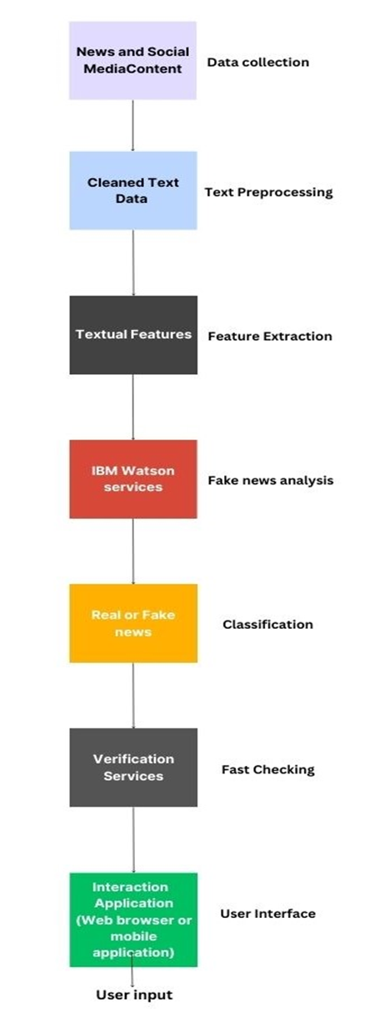

Slide 8
METHODOLOGY
Using this model, a tool is implemented for detecting the fake articles. In this method supervised machine learning is used for classifying the dataset. The first step in this classification problem is dataset collection phase, followed by preprocessing, implementing features selection, then perform the training and testing of dataset and finally running the classifiers. describes the proposed system methodology. The methodology is based on conducting various experiments on dataset using the algorithms described in the previous section named Random forest, SVM and Naïve Bayes, majority voting and other classifiers.

Slide 9
METHODOLOGY
The main goal is to apply a set of classification algorithms to obtain a classification model in order to be used as a scanner for a fake news by details of news detection and embed the model in python application to be used as a discovery for the fake news data . Also, appropriate refactorings have been performed on the Python code to produce an optimized code. The classification algorithms applied in this model are k-Nearest Neighbors (k-NN), Linear Regression, XGBoost, Naive Bayes, Decision Tree, Random Forests and Support Vector Machine (SVM). All these algorithms get as accurate as possible. Where reliable from the combination of the average of them and compare them

Slide 10
METHODOLOGY
In the process of model creation, the approach to detecting political fake news is as follows: First step is collection political news dataset, (the Liar dataset is adopted for the model), perform preprocessing through rough noise removal, the next step is to apply the NLTK (Natural Language Toolkit) to perform POS and features are selected. Next perform the dataset splitting apply ML algorithms (Naïve bays and Random forest) then create the proposed classifier model. The Fig 2 shows that after the NLTK is applied, the Dataset gets successfully preprocessed in the system, then a message is generated for applying algorithms on trained portion. The system response with N.B and Random forest are applied, then the model is created with response message. Testing is performed on test dataset, and the results are verified, the next step is to monitor the precision for acceptance.

Slide 11
METHODOLOGY
The model is then applied on unseen data selected by user. Full dataset is created with half of the data being fake and half with real articles, thus making the model’s reset accuracy 50%. Random selection of 80% data is done from the fake and real dataset to be used in our complete dataset and leave the remaining 20% to be used as a testing set when our model is complete. Text data requires preprocessing before applying classifier on it, so we will clean noise, using Stanford NLP (Natural language processing) for POS (Part of Speech) processing and tokenization of words, then we must encode the resulted data as integers and floating point values to be accepted as an input to ML algorithms. This process will result in feature extraction and vectorization; the research using python scikit-learn library to perform tokenization and feature extraction of text data, because this library contains useful tools like Count Vectorizer and Tiff Vectorizer. Data is viewed in graphical presentation with confusion matrix.

Slide 12
STRATEGY AND DEPLOYMENT
The proposed solution suggests utilizing IBM Watson's capabilities in natural language processing (NLP) and machine learning to detect and analyze fake news in social media. The method involves collecting a dataset of social media posts and news articles, preprocessing the data by removing irrelevant content and performing text preprocessing tasks, extracting features using techniques like TF-IDF, training a machine learning model on the labeled dataset to distinguish between real and fake news, evaluating the model's performance, analyzing real-time social media content using the trained model, making decisions based on a likelihood score threshold, and continuously improving the model with new data and feedback. By combining NLP techniques and machine learning, the proposed solution aims to provide an automated and efficient approach to combat the spread of fake news, contributing to more reliable information dissemination in social media platforms.

Slide 13
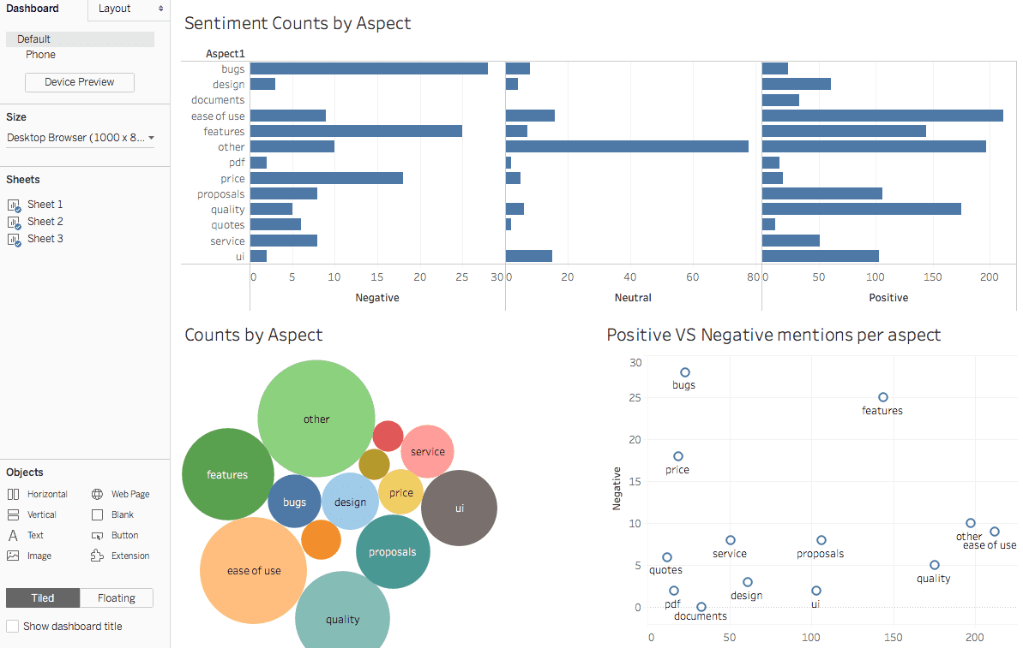

Slide 14
Investigating and selecting the most relevant features for detecting fake news. This analysis may involve evaluating different feature extraction techniques and their impact on the accuracy of the classification model. Techniques such as TF-IDF (Term Frequency-Inverse Document Frequency) can be explored to identify informative features.

Slide 15
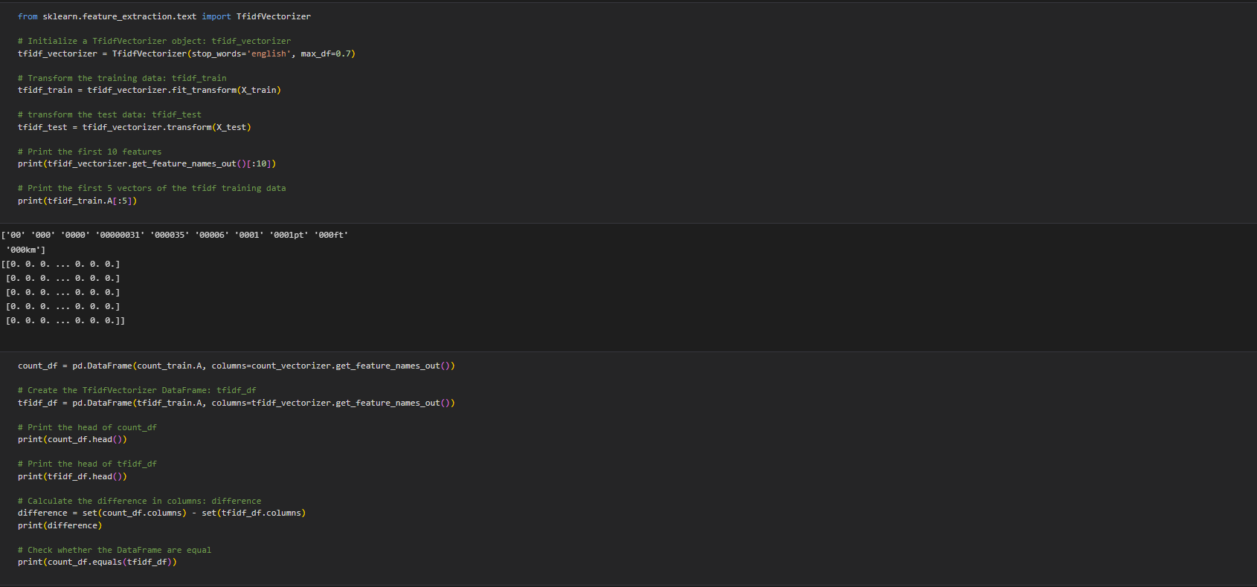
CODE

Slide 16
IBM Watson is utilized in this project, "Fake News Analysis in Social Media using IBM Watson," for its cutting-edge natural language processing (NLP) and cognitive computing capabilities. IBM Watson offers a robust set of tools and services that enable efficient analysis and classification of news articles and social media content. Leveraging Watson's NLP capabilities allows for the extraction of meaningful insights from unstructured text data, facilitating the identification of linguistic cues and patterns indicative of fake news. Additionally, IBM Watson's machine learning capabilities enable the development of accurate classification models that can distinguish between real and fake news with high precision. The integration of Watson's cognitive computing also facilitates fact-checking, cross-referencing information with trusted sources, and verifying the credibility of news content. By harnessing the power of IBM Watson, this project gains a competitive advantage in its ability to analyze vast amounts of data, detect fake news efficiently, and provide users with reliable information to foster a more informed and responsible online community.

Slide 17
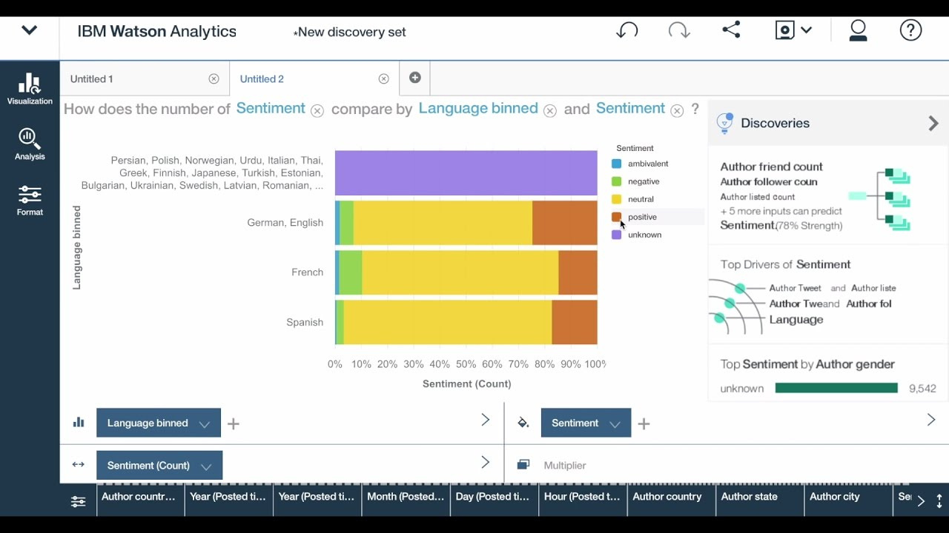

Slide 18
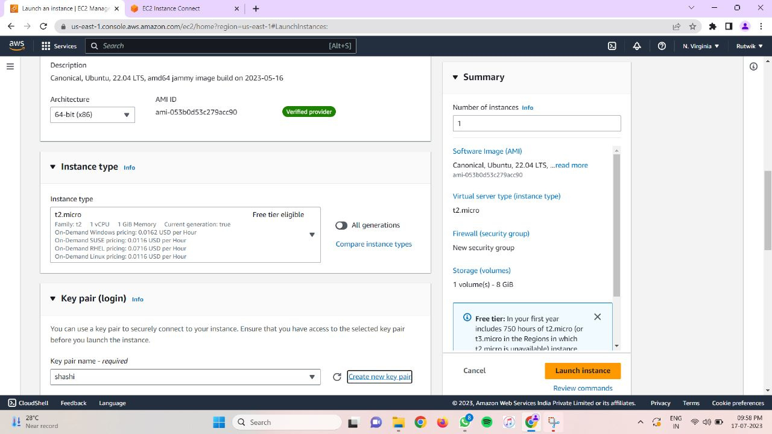

Slide 19
We'll then configure web servers like Nginx or Apache to serve the frontend and application servers like Node.js or Flask to handle backend requests. Setting up a database, such as MySQL or PostgreSQL, will enable storing and managing blog data efficiently.
Additionally, we'll cover domain setup and SSL certificate installation for secure access to the website. If necessary, we'll explore optional features like Auto Scaling and Load Balancing to optimize performance during high traffic periods.
Monitoring and maintenance are crucial aspects of any web application, so we'll highlight the significance of monitoring the EC2 instance's performance with CloudWatch and the importance of regular backups and data maintenance.

Slide 20
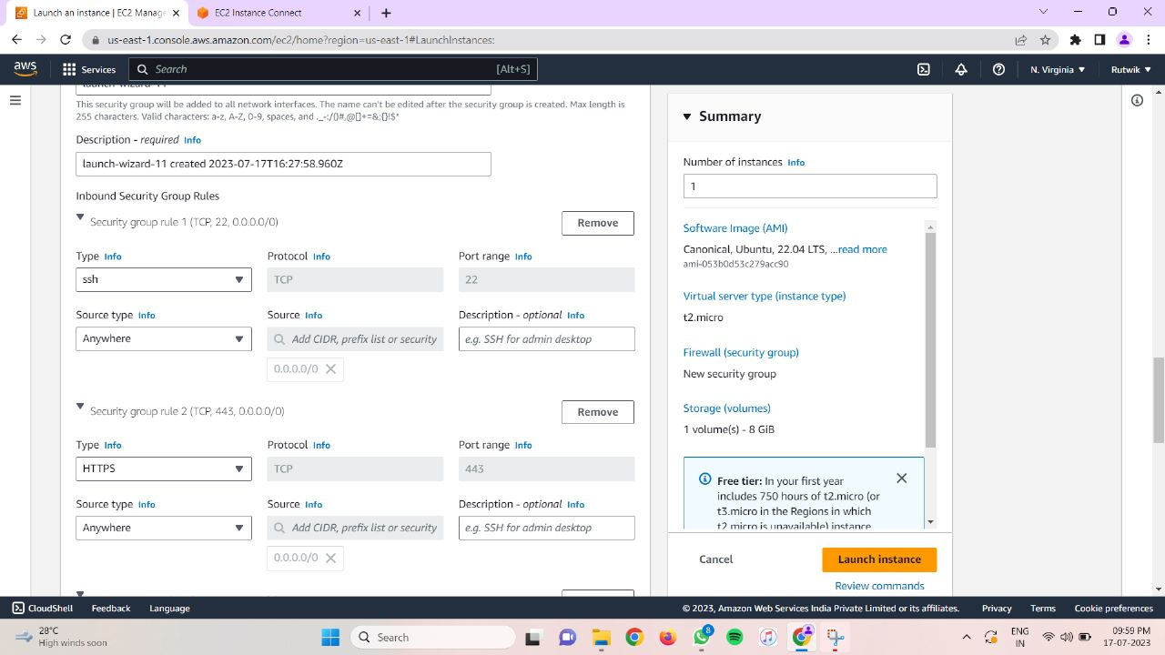

Slide 21
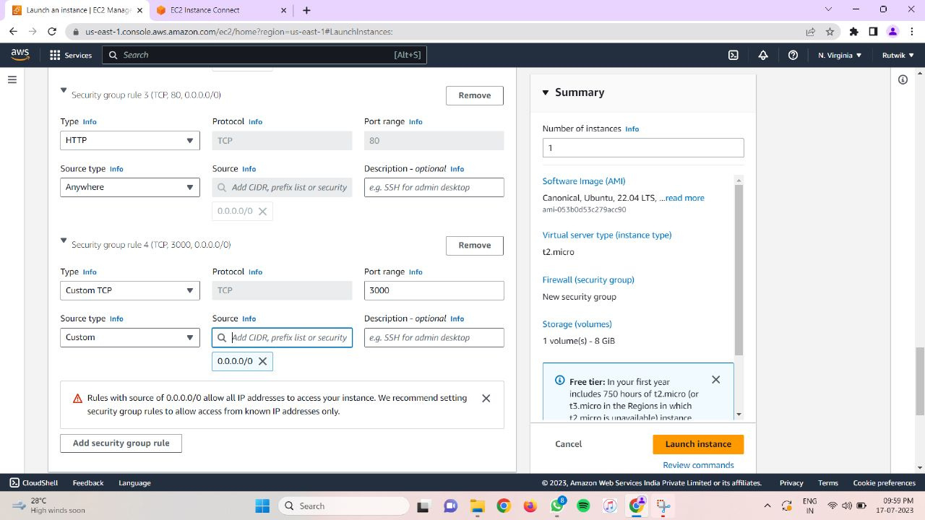

Slide 22
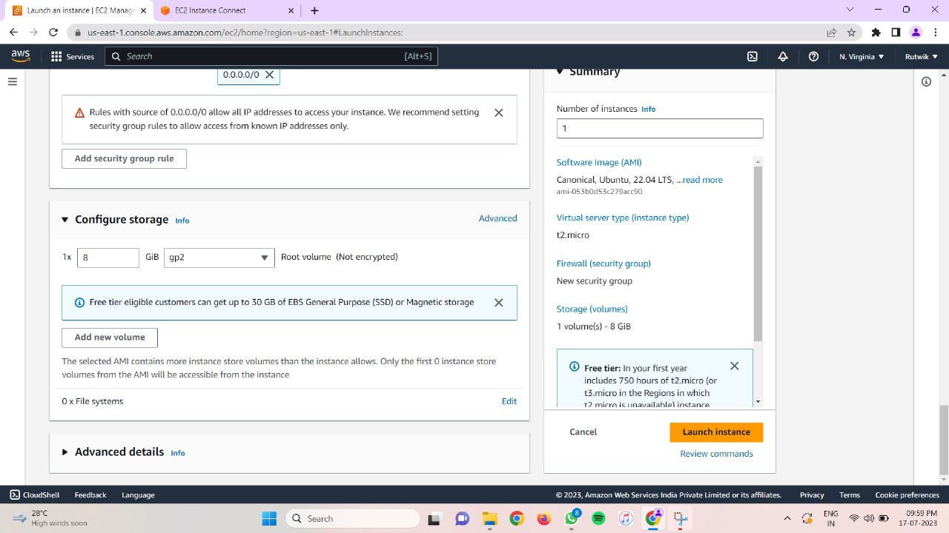
Finally, we'll focus on cost optimization strategies for AWS EC2 usage, such as leveraging Reserved Instances or Spot Instances, and emphasize the importance of monitoring costs to optimize resource utilization.

Slide 23
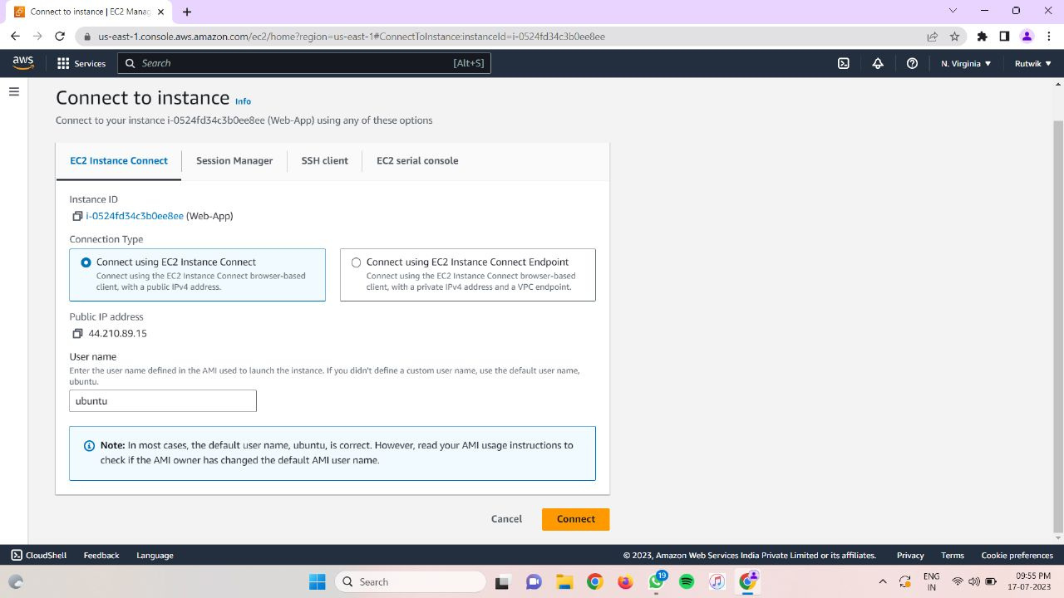
Connecting to instance

Slide 24

Status of the application
Succesfully Deployed application

Slide 25
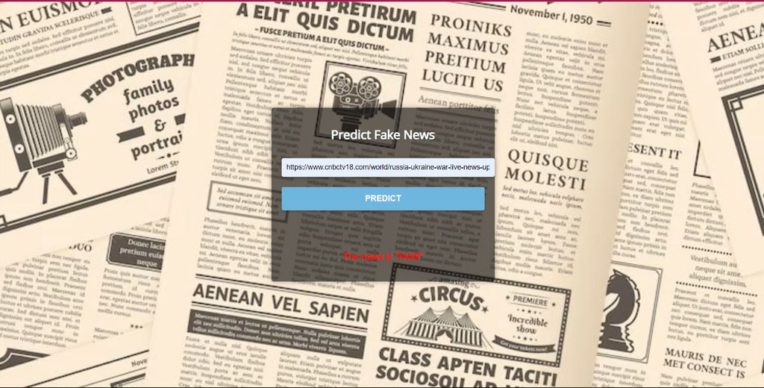
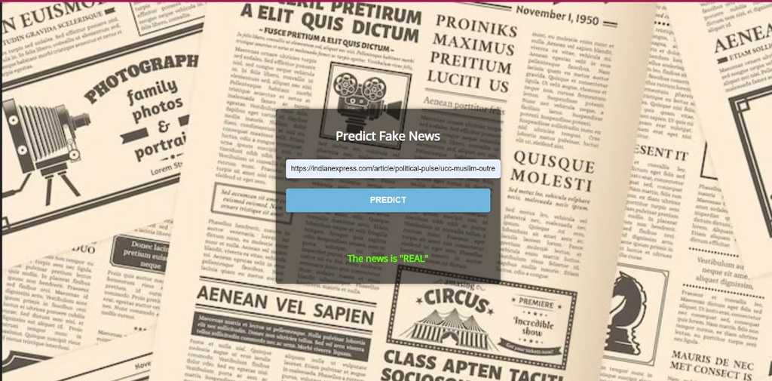
Adding new blogs

Slide 26
RESULTS
The scope of this project is to cover the political news data, of a dataset known as Liar-dataset, it is a New Benchmark Dataset for Fake News Detection and labeled by fake or trust news. We have performed analysis on "Liar" dataset . The results of the analysis of the datasets using the six algorithms have been depicted using the confusion matrix. The six algorithms used for the detection are as:
• XGboost.
• Random Forests.
• Naive Bayes.
• K-Nearest Neighbors (KNN).
• Decision Tree. • SVM

Slide 27
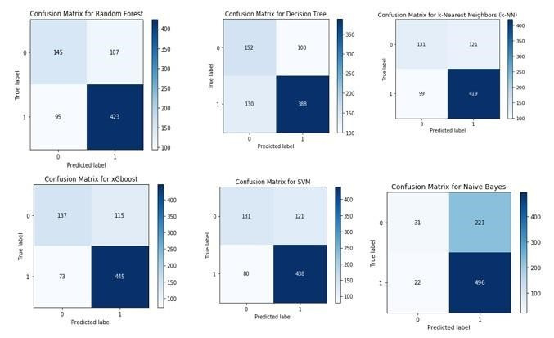
THE CONFUSION MATRIX

Slide 28
CONCLUSION
the fake news detection approaches presented in the paper utilize text analysis models based on speech characteristics and predictive models that differ from current ones. utilizes a Naive Bayes classifier to detect fake news from various sources, achieving an accuracy of 74%. combines ML algorithms, but relies on an unreliable probability threshold with an accuracy ranging from 85% to 91%. uses Naive Bayes to detect fake news from different social media platforms, but the results are inaccurate for untrustworthy sources. obtains data from Kaggle with an average accuracy of 74.5%. uses Naive Bayes algorithms to detect Twitter spam senders, with accuracy ranging from 70% to 71.2%. explores different approaches with an accuracy of 76%. employs three common methods: Naïve Bayes, Neural Network, and Support Vector Machine (SVM). Naïve Bayes achieves an accuracy of 96.08% for detecting fake messages, while Neural Network and SVM reach 99.90%. combines KNN and random forests, resulting in an 8% improvement in fake message detection. examines the performance of 8 supervised machine learning classifiers on the 2012 Dutch elections fake news on Twitter, concluding that the decision tree algorithm performs best with an F score of 88%. presents a counterfeit detection model using N-gram analysis, achieving the highest accuracy of 92% with a unigram and linear SVM.

Slide 29
REFERENCES
https://enlear.academy/deploy-a-node-appv16-x-x-on-aws-ec2-using-cicd-pipeline-6474e012d029
2. https://sumantmishra.medium.com/how-to-deploy-node-js-app-on-aws-with-github- db99758294f1
3. https://timesofindia.indiatimes.com/blogs/chennaitalkies/tomato-turns-red-and-writes-a-letter/

Slide 30

THANK YOU

